Slide 1
KNN VS NAIVE BAYES CLASSIFICATION
A COMPARATIVE STUDY

Slide 2
TABLE OF CONTENTS
01
02
03
NAIVE BAYES OVERVIEW
KNN OVERVIEW
COMPARISON THEORY

Slide 3
TABLE OF CONTENTS
04
05
06
DATASET OVERVIEW
Practical comparison
results

Slide 4
NAIVE BAYES
The Naive Bayes Classifier technique is based on Bayesian Theorem and it is used when the dimensionality of the inputs is high.

Slide 5
Naive bayes features
generative classifier
eager learning CLASSIFIER
model that generates the data behind the scenes by estimating the assumptions, distributions of the model
faster than K-NN. Thus, it could be used for prediction in real time
probabilistic estimation
USED IN TEXT CLASSIFICATION
uncertainties associated with each project component
It’s used in email filtering and sentiment analysis

Slide 6
ADVANTAGES
It requires short computational time for training.
It improves the classification performance by removing the irrelevant features.
It has good performance.

Slide 7
DISADVANTAGES
The Naive Bayes classifier requires a very large number of records to obtain good results.
Less accurate as compared to other classifiers on some datasets.

Slide 8
KNN CLASSIFIER
It is based on the principle that the samples that are similar, generally lies in close vicinity
Nearest-neighbor classifiers are based on learning by resemblance, i.e. by comparing a given test sample with the available training samples which are similar to it.
K-NN works on the belief that the data is connected in a feature space. Hence, all the points are considered in order, to find out the distance among the data points. ED-HD is used according to the data type of data classes used

Slide 9
steps
Initialize value of K.
Calculate distance between input sample and training samples.
Sort the distances.
Take top K- nearest neighbors.
Apply simple majority.
Predict class label with more neighbors for input sample.

Slide 10
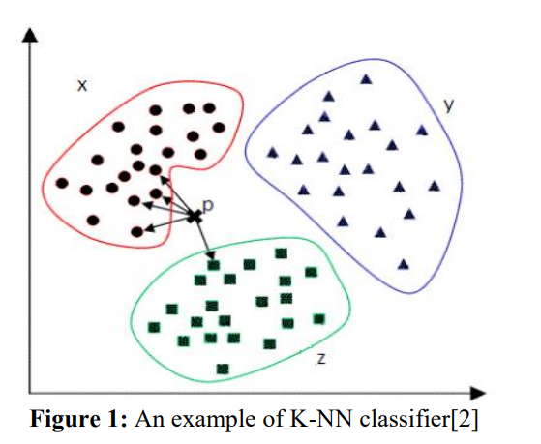
ADVANTAGES
Easy to understand and implement.
Training is very fast.
It is robust to noisy training data.
It performs well on applications in which a sample can have many class labels.

Slide 11
Disadvantages
Lazy learners incur expensive computational costs when the number of potential neighbors which to compare a given unlabeled sample is large
It is sensitive to the local structure of the data.
Memory limitation.
As it is supervised lazy learner, it runs slowly.

Slide 12
KNN VS NAIVE BAYES
KNN
NAIVE BAYES
Provides high accuracy.
For obtaining good results it requires a very large number of records.
1
Accuracy
1
Accuracy
Small data
Huge data
2
Effectiveness on
2
Effectiveness on
Slower for large data
Faster than KNN.
3
Speed
3
Speed
It can’t deal with noisy data.
It can deal with noisy data
4
Dataset
4
Dataset

Slide 13
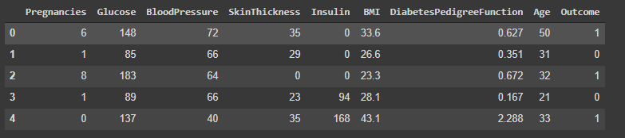
DATASET OVERVIEW
We chose a medical dataset, where the result to be predicted was weather a person would get diabetes or not there are 8 data points to predict it.

Slide 14
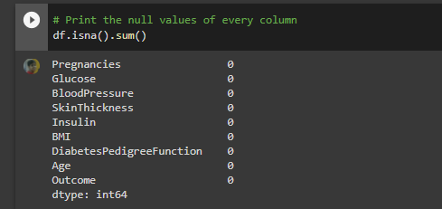
DATASET OVERVIEW
We hadeled the NA values, there were none.

Slide 15
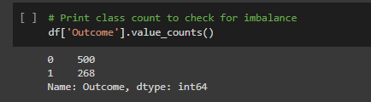
DATASET OVERVIEW
We found this data to be skewed which is not ideal for these types of classification. However, it is indicative of real life data as irl we observe less of the population ultimately is affected by diabetes but we decided to upsample the data to get better results.

Slide 16
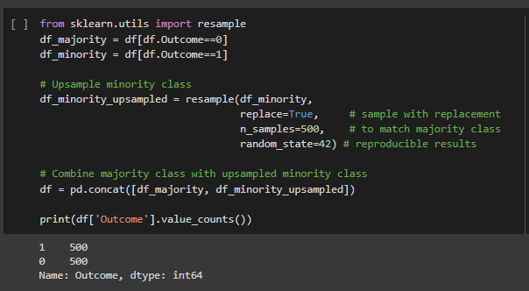
DATASET preprocessing-UPSAmpling
We upsampled the data so that the algos work better

Slide 17
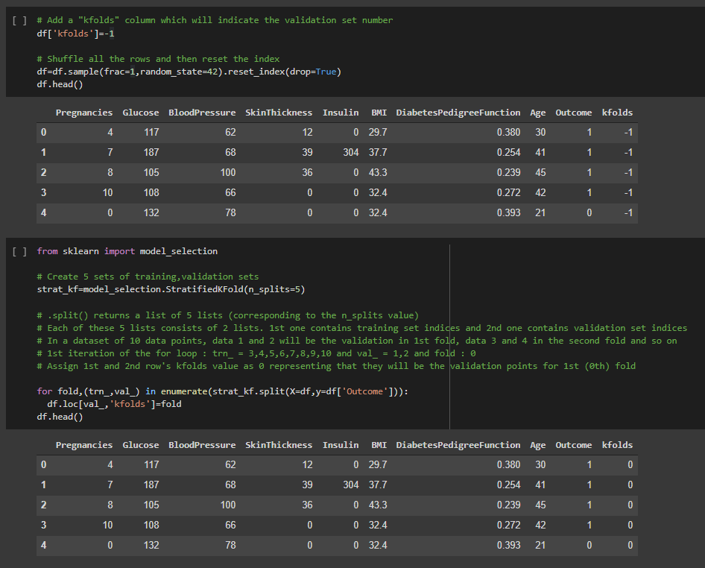
DATASET preprocessing
We added the kfolds column, and jumbled the rows, then we added a seed to preserve this iteration then added folds for 5 splits. [0 to 4] for eg if this dataset was 10 items long 2 items for valid and 8 for train each fold.

Slide 18
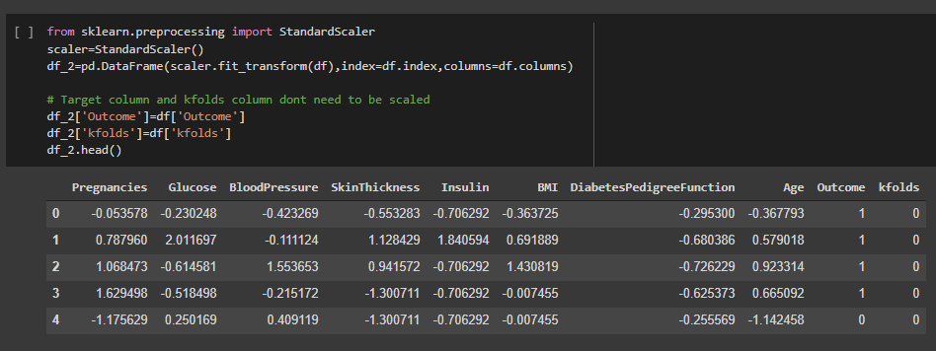
Dataset preprocessing-scaling
We scaled the dataset in normal distribution then unscaled the outcome and kfolds cus that has no need to be scaled.

Slide 19
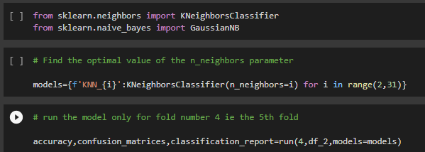
Then we OPTIMISED the KNN ALGO.

Slide 20
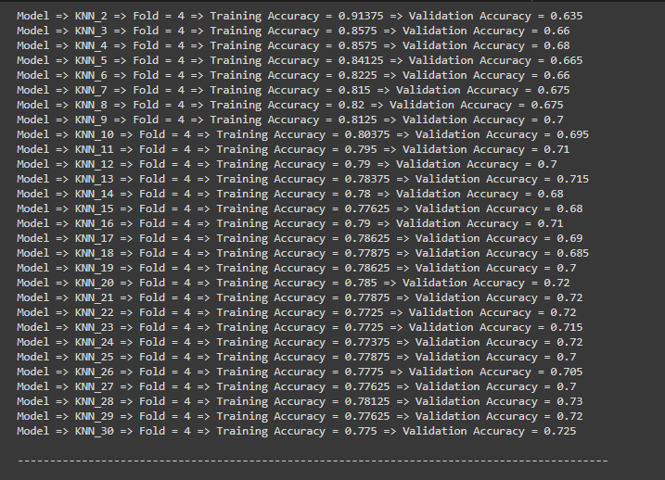
28 was optimum!

Slide 21
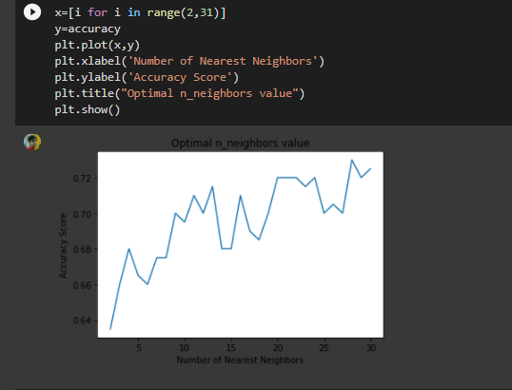
Here is a plot to visualise the optimization:

Slide 22
We’ll see the classifications in action in the demo, here are the results we obtained!

Slide 23
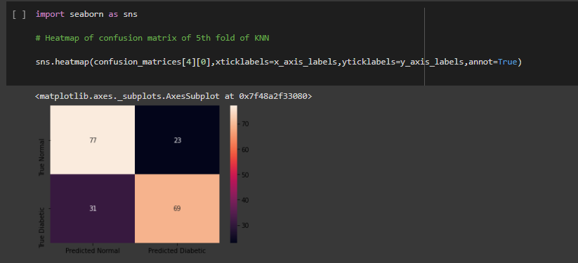
RESULTS- HEATMAPS-KNN
Here we, need to observe that in medical datasets type b errors are not tolerated thus PD-TD should be high, which it is, its 69 Nice, which is high and an acceptable result.

Slide 24
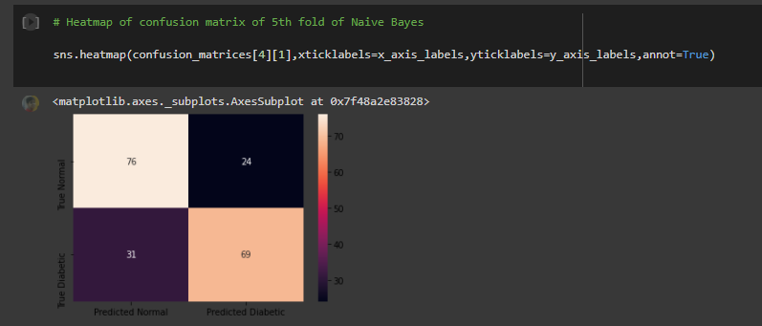
RESULTS- HEATMAPS-NAIVE BAYES
Here , observe that since we upscaled this dataset, as opposed to previous iterations of this experiment when we did not, we got similar results for the relevant TD-PD heatmap, which is 69 nice, which is the same as knn

Slide 25
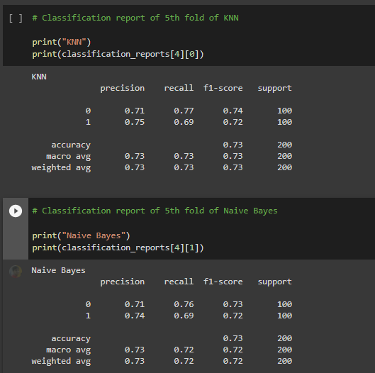
Results obtained-CLASSIFICATION REPORT.

Slide 26
CONCLusion
The comparative study has shown that each algorithm has its own set of advantages and disadvantages as well as its own area of implementation. None of the algorithm can satisfy all constraints and criteria. Depending on application and requirements, specific algorithm can be chosen. Here we obtained similar results for both, thus this leaves more room for further comparison

Slide 27
THANK YOU!

